Slide 1

Introduction to First Half Course Topics
Marlon Pierce, Suresh Marru
Science Gateways Research Center, Indiana University
marpierc@iu.edu, smarru@iu.edu

Slide 2
Monolithic Applications: Traditional Software Releases
Software releases occur in discrete increments
Software runs on clients’ systems
Releases may be frequent but they are still distinct
Firefox
OS system upgrades
Traditional release cycles
Extensive testing
Alpha, beta, release candidates, and full releases
Extensive recompiling and testing required after code changes
Code changes require the entire release cycle to be repeated

Slide 3
MicroServices: Software as a Service
Does your software run as a service?
Do you run this service yourself? Or does another part of your organization run the service that your team develops?
Traditional release cycles don’t work well
May make releases many times per day
Test-release-deploy takes too long
You can be a little more tolerant of bugs discovered after release if you can fix quickly or roll back quickly.
Get new features and improvements into production quickly.
Science gateways provide software as a service

Slide 4
Science Gateways and Microservices

Slide 5
What Is a Microservice?
Develop a single application as a suite of small services
Each service runs in its own process
Services communicate with lightweight mechanisms
“Often an HTTP resource API”
But that has some problems
Messaging and hybrid approaches
These services are built around business capabilities
Independently deployable by fully automated deployment machinery.
Minimum of centralized management of these services,
May be written in different programming languages
May use different data storage technologies.
http://martinfowler.com/articles/microservices.html

Slide 6
Recall the Gateway Octopus Diagram
Browser
HTTPS
Web Interface Server
Client SDK
HTTP or TCP/IP
We will focus on this piece
Server SDK
Application Server
Resource Plugins
Karst: MOAB/Torque
Stampede: SLURM
Comet: SLURM
Jureca:SLURM

Slide 7
Basic Components of the Gateway App Server
API Server
Server SDK
Application Server
Application Manager
Metadata Server
Resource Plugins

Slide 8
Decoupling the App Server
API Server
Application Manager
Metadata Server
API Server
API Server
API Server
API Server
Application Manager
Metadata Server
Application Manager
Metadata Server
Application Manager
Metadata Server
Application Manager
Metadata Server
Application Manager
Metadata Server
Application Manager
Metadata Server

Slide 9
How Do We Package and Where Do We Run All Those Microservices?
On the Cloud? In the Matrix?

Slide 10
Virtualization, Containers, Docker

Slide 11
Hypervisor Virtualization
Hypervisors provide software emulated hardware and support multiple OS tenants.
Type 1 Hypervisors run directly on the hardware
Kernel-based Virtual Machine (KVM)
Xen: Amazon uses (or used) this
Type 2 Hypervisors run as another program in the HostOS
Virtual Box
VMWare

Slide 12
Virtualization Benefits and Drawbacks
Makes your development, testing, and deployment environments the same
Supports Continuous Integration and Deployment
Adds overhead
Relatively slow to create and destroy VMs
Virtualized hardware and networking are slower than real systems
Uses memory, disk, and CPU resources
You can run 1 VM per microservice, but there is a better way.

Slide 13
Docker and Other Linux Containers
Docker replaces the need for DIY containers
Docker uses LXC containerization + AuFS
AuFS lets Docker containers share common files
AuFS also allows you to have efficient version control of container images
Because each container has its own thin writable container layer, and all changes are stored in this container layer, multiple containers can share access to the same underlying image and yet have their own data state.

Slide 14
How Do Microservices Communicate?
Push, pull, etc

Slide 15
Messaging Systems: RabbitMQ, Apache Kafka

Slide 16
Simple Work Queue
AppMan Worker
MSG 1
Gateway API Server
RabbitMQ Broker
ACK
AppMan Worker
MSG1, 2, 3
MSG 2
ACK
ACK
3 Job requests come to the API Server
API Server publishes to Broker (Exchange + Message Queue)
Broker sends to workers in round-robin
Workers send ACKs when done
If Broker detects a closed connection before an ACK, sends MSG to a different worker
MSG 3
AppMan Worker

Slide 17
How Can Components Expose their APIs and Data Models to Other Components?
And can we make this programming language independent?

Slide 18
API and Metadata Model Design

Slide 19
How Can I Discover, Monitor, and Manage Services?
Can we learn some lessons from distributed systems research?

Slide 20
Distributed State Management: Zookeeper, Consul

Slide 21
How Do I Manage Logs from Microservices
And detect if there are problems

Slide 23
How Can I Secure my API Server and Microservices?
How do I manage user identities, authentication and authorization?

Slide 24
Security: OAuth2 and OpenIDConnect

Slide 25
How Does the Gateway Interact with Computing Clouds and Supercomputers?
How can we work reliably with unreliable resources?

Slide 26
Micro-Services
DevOps
Distributed Systems

Slide 27
Resource Management and Scheduling: Mesos, Aurora, and Torque

Slide 28
How Can We Automate All of This?
How can we make our infrastructure reproducible?

Slide 29
Putting It All In Place: Continuous Integration and Deployment

Slide 30
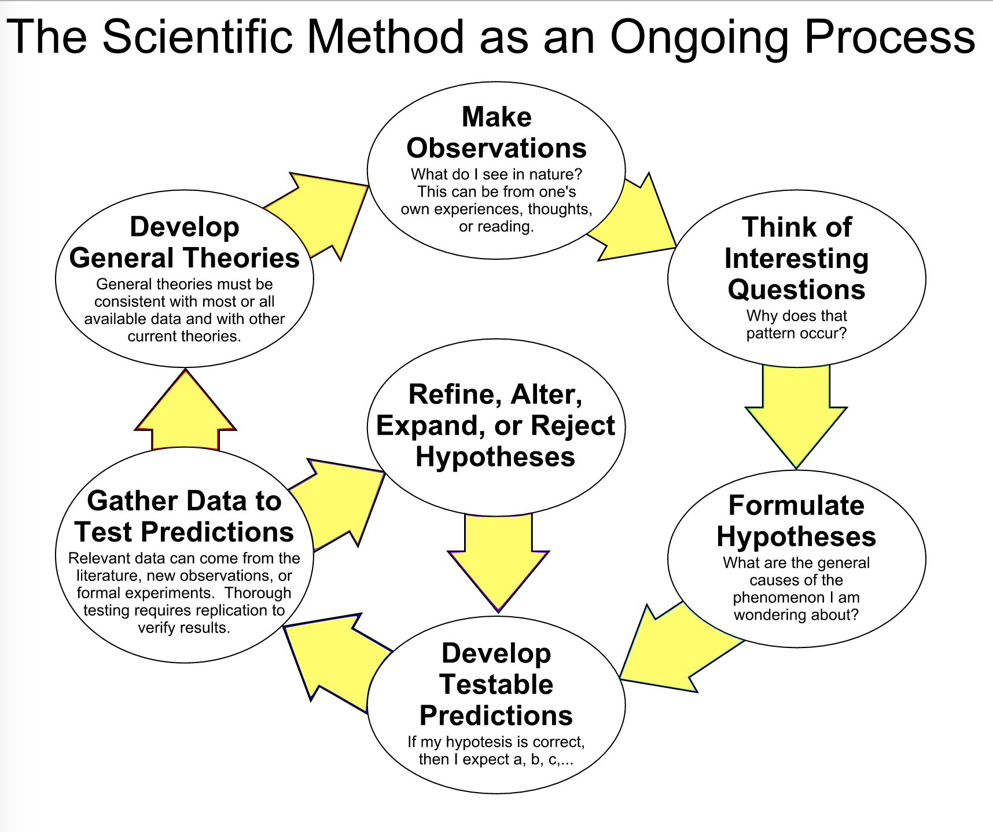
Next Semester: Science!

